Slide 1
I
NASAR
Laravel & React
“YOUR FUTURE IS CREATED BY WHAT
YOU DO TODAY }
NOT TOMORROW”
{

Slide 2

What is Laravel
PHP framework
To make website and API.
Easy to learn.
Most used PHP framework.
MVC Pattern.

Slide 3
What is Framework
A platform written programming language.
That has more features, tools and function than a programming language
For fast and easy development
Feature example
Routing
DB connection
Well manage code
project structure

Slide 4
01
MVC Architecture Support
02
Eloquent Object Relational Mapping
Features of PHP
Laravel
03
High-Level Security
Libraries & Modular
Framework
04
Easy Tool Integration
Database Migration System
https://www.youtube.com/watch?v=jDScsOFi4G4

Slide 5



Tools for start with Laravel
PHP AND composer(we can use Herd)
Laravel package
We can use any OS (Windows, Mac, Linux)

Slide 6
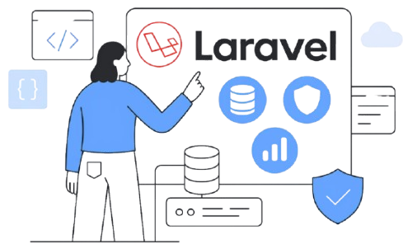
Why Laravel
Most used PHP framework.
Large community.
Regular update.
A lot of features.
Open-Source Framework
Supports Popular Database Engines
Routing System
Migrations System
The command line is awesome.

Slide 7


Create Laravel App
Install XAMPP for PHP, MySQL, and PHPMyAdmin
Install Composer
Install Laravel
Make Laravel app
Check App is running
Check Laravel Version

Slide 8

XAMPP and composer
Xampp is a tool that installs PHP, MySQL quicky
Composer is a package management tool in PHP that A helps manage libraries by automatically installing and updating them.
So with Composer we can install laravel easy and update laravel easily.
XAMPP

Slide 9
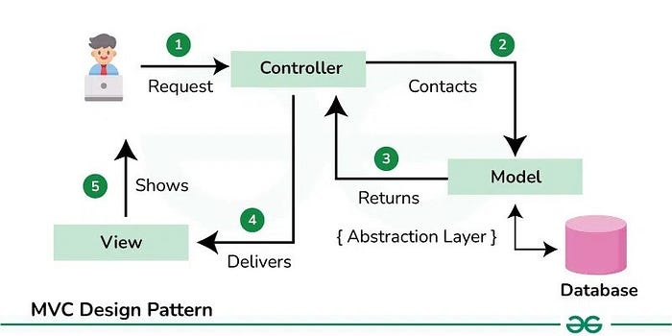
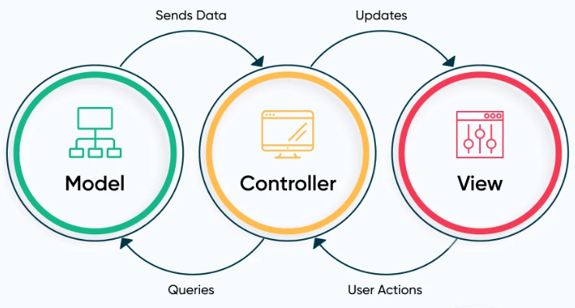
What is MVC
MVC is a Software design pattern to develop reliable software applications.
In MVC we divide applications in three parts
Models: Write Business logic, database communication
View: User interface (Code we write to display on UI)
Controller: Handle user interaction and select a view to render, communicate Model and View
Laravel MVC Architecture

Slide 10
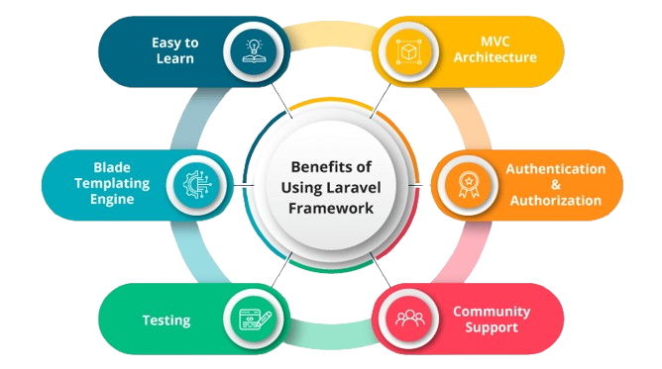



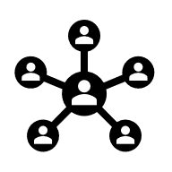

Slide 11
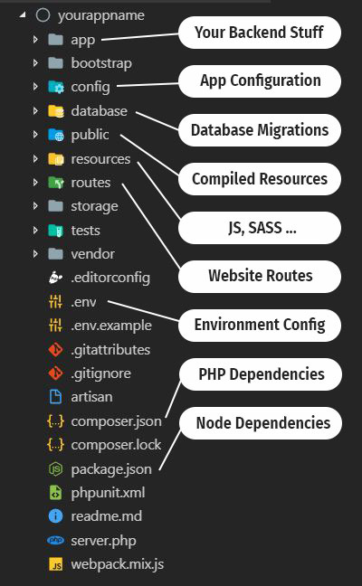
File and Folder Structure & Create File in Laravel
Important file and folder
Where we create MVC files.
Basics of all folder
Make First Change
Make First File

Slide 12
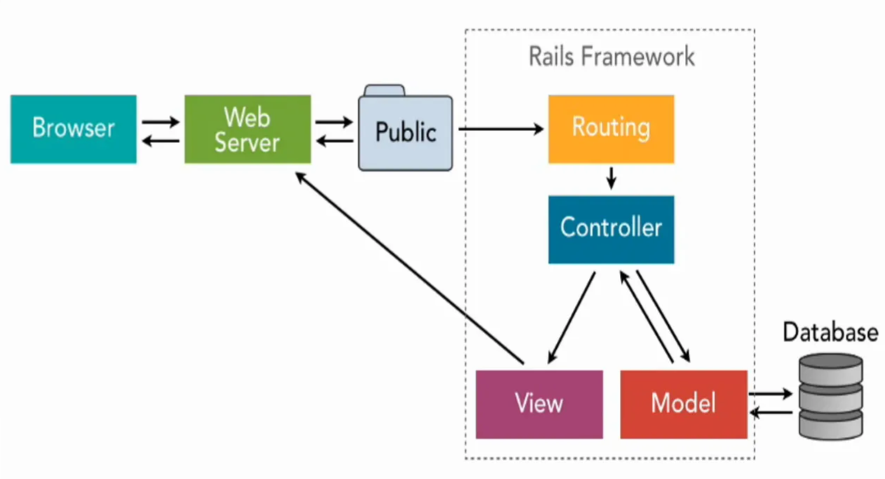
Routing in Laravel
What is Routing
How to make route
Open View with routing
Pass data with routing
Anchor tag
Redirect with routing
Routing methods
Routing is a path for opening a webpage.
Or URL for opening å file
www.test.com/welcome.php
welcome.blade.php we can open it with any URL
http://localhost:8000/
http://localhost:8000/welcome
http://localhost:8000/anything

Slide 13
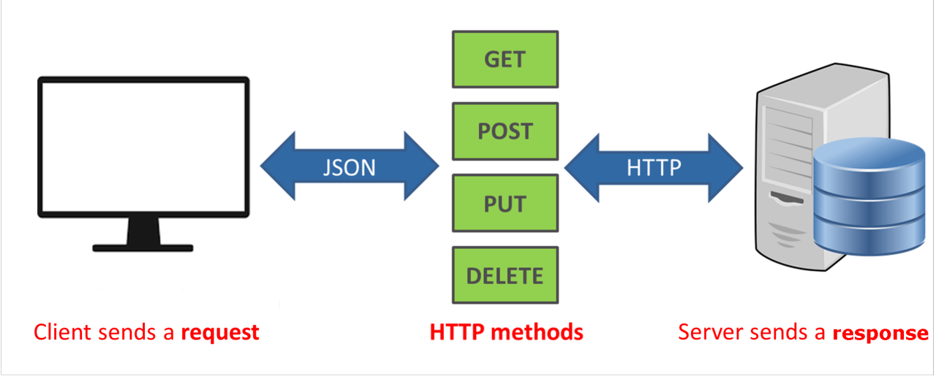
Routing Methods in Laravel
Route::get($uri, $callback);
Route::post($uri, $callback);
Route::put($uri, $callback);
Route::patch($uri, $callback);
Route::delete($uri, $callback);
Route::options($uri, $callback);

Slide 14
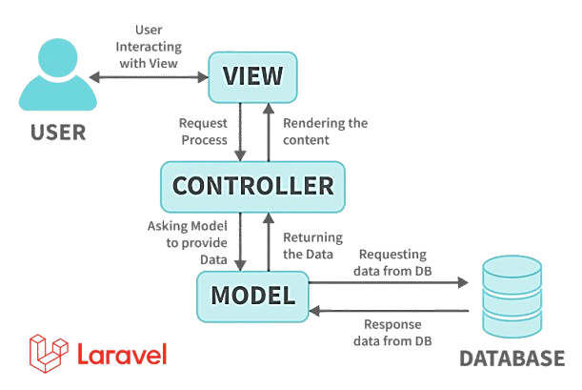
Controller in Laravel
What is controller
How to make controller
Call controller with routes
Pass data from router to controller
Call view with controller
Call view which is under a nested folder
The Controller comes under MVC architecture.
The Controller handles requests from user
Display view.
Handle database
We can say that:- the controller is a central unit that handles user request, model and views

Slide 15
View in Laravel
What is View
How to make View
How to make view with command line
Call view from route and controller
Make nested view and call
Pass data in view
How to know view exist or not

Slide 16
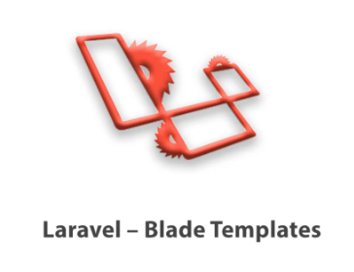
Blade Template in Laravel
Blade Template in Laravel
What is blade template?
Why do we need blade template?
Expression of blade template
Display variables
Execute functions
If else
For loop
Forearch
Blade is a simple, yet powerful templating engine for executing PHP code
This is included in the Laravel framework
The template engine is a module or tool for executing code
We can write PHP tags also in the blade template
To use blade template view should end with the .blade.php extension

Slide 17
Including Sub Views in Laravel
What is subview
Make sub views
Use subview
Pass data from view to subview.
Check if sub view exists
Home
include
Common View
(Header)
Sub view

Slide 18
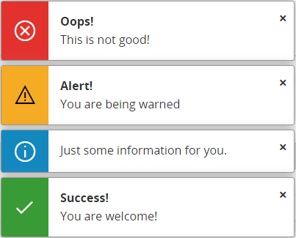
Component in Laravel
What is component
How to make component
How to use component
How to pass data in component
Example of component
A piece of code that can reuse in our project.
Like a function is written once can reuse again and again.
We can make a component and reuse it again and again.
Component can be reused in the same file as well as different files also.

Slide 19
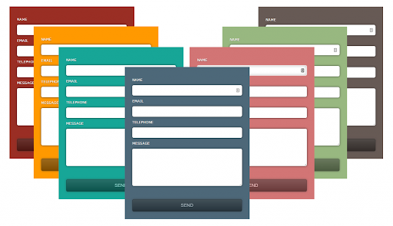
Form and input fields
Make View and its Route
Make form and input fields.
Make checkbox
Make Radio button
Make Range
Make Dropdown
Make controller and get value
Make form submit route
Get form input field data

Slide 20
Form Validation
Apply validation for input
Display validation message
Display validation with input fields
Make a custom error message
Get old value
Change input color if invalid
Publish validation message file
Make Own Validation Rule
What is the Validation rule
Make custom rule, Apply custom rule
Update custom rule message

Slide 21
URL Generation
What is URL Generation
Get current URL
Get full URL
Get the previous URL
Make link URL
Make URL with child path

Slide 22
Named Routes
What is Named Routes?
How to make a named route
How to use the named route from View
How to use name route from controller
How to pass params in named route

Slide 23
Route Group with prefix
What is Route grouping with prefix?
Make Some Routes for view and controller
Make Groups of routes
1 Route::view('student/home', 'home');
2 Route::get('student/show', [HomeController::class, 'show']);
3 Route::get('student/save', [HomeController::class, 'save']

Slide 24
Route Group with Controller
What is Route grouping with controller?
Make Some Routes for controller
Make Route Groups of controller
1 Route::get('show', (HomeController::class, 'show']);
2 Route::get('add', (HomeController::class, 'add']);
3 Route::get('about/{name}', [HomeController::class, 'about']);

Slide 25
Middleware in LaravelZ
What is Middleware?
Type of middleware.
Make middleware
Apply Middleware
Filter request with middleware
Middleware is a layer between the user and Application.
Here we can check conditions or filter user requests.
If condition pass request will reach to middleware
Type of Middleware
Global Middleware
Route Middleware
Group Middleware
Request
Middleware
Control/View

Slide 26
Type of Middleware
Global Middleware
Route Middleware
Group Middleware
What is Middleware Group
How to register Middleware in a group
Apply a group of middleware to Route Group
Apply group of middleware to Single Route
Middleware can apply on Single Route
Middleware can apply on Route Group
Middleware can apply on all Route
Request
Middleware
Control/View

Slide 27
Assigning Middleware to Routes
Make Middleware
Make Routes
Apply middleware on the route
Apply multiple middleware on Route
Request
Middleware
Control/View

Slide 28
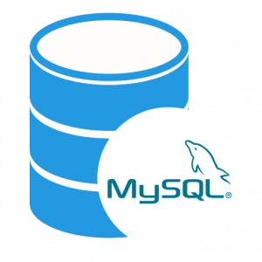
Connect to MySQL Database in Laravel
Make Database
Update Env file
Run migration
Make controller and route
Get data from the database
Connection to DB without migration

Slide 29
Display DB Data on UI
Make View
Call view from controller
Pass DB data from the controller to view
User for each loop display data

Slide 30
Eloquent Model in Laravel
What is Model
Make a table in the database
Check .env file configuration
Make Controller
Make Model
Make View
Get data from the database
Pass data to view and display data
Make function in Model and Use it

Slide 31
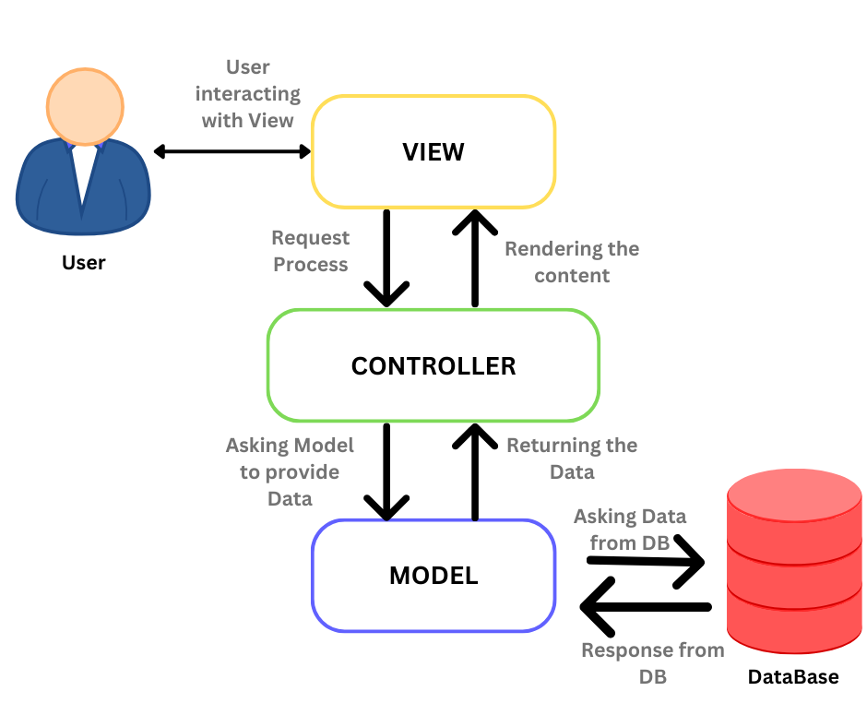
What is model
Part of MVC architecture
This is a PHP file with class
Here we write business logic and DB connections
But in Laravel we mostly do DB related work
In Laravel we have an Object-relational mapper (ORM) Feature

Slide 32
Inspecting Model
What is Inspecting the model
How to use it
Check DB Table details

Slide 33
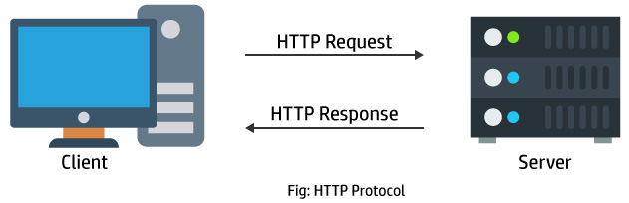
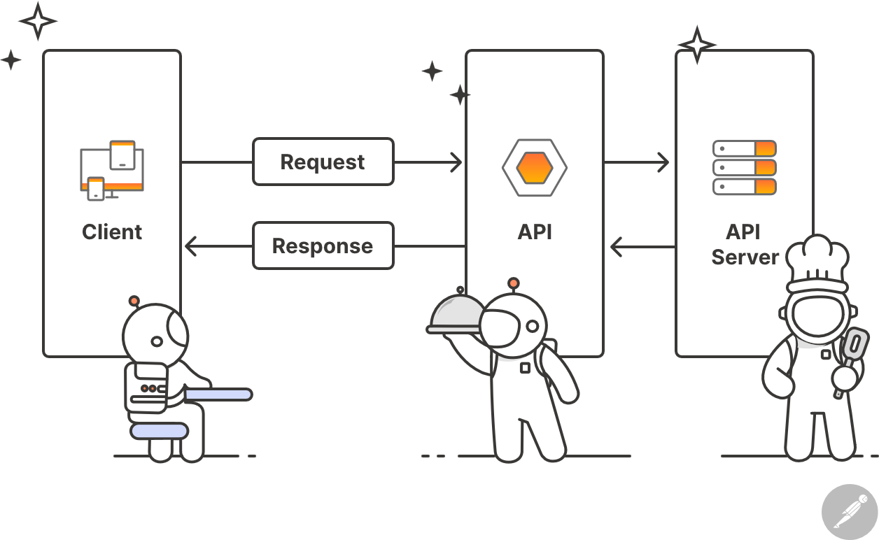
Http Client
What is HTTP Client
Make Controller, Route and View
How to use HTTP Client
Call API with HTTP Client
API (Application programming interface) can pass data from
1 Programming language to other
1 Framework to other
1 Project to other
API has JSON format data

Slide 34
Database: Query Builder
What is Query Builder
Get data from DB with query builder
Make Queries like where, get first etc
Insert data.
Update data.
Delete data.

Slide 35
Database: Query Builder
What is Query Builder
Get data from DB with query builder
Make Queries like where, get first etc
Insert data.
Update data.
Delete data.
Database query builder provides a convenient way to creating and running database queries
E.g:- get data, where condition, order by, update data, delete data, max, min value etc

Slide 36
Eloquent Model: Query Builder
What is Eloquent Model Query Builder
Get data from DB with query builder
Make Queries like where, get first etc
Insert data.
Update data.
Delete data.

Slide 37
Laravel Route methods
What is Route?
Route methods name
Make forms for the use of route methods
Example of all route methods
Route::get($uri, $callback);
Route::post($uri, $callback);
Route::put($uri, $callback);
Route::patch($uri, $callback);
Route::delete($uri, $callback);
Route::options($uri, $callback);
Route::view($uri, $callback);

Slide 38
Laravel HTTP Request Class
What is HTTP Request class
Make HTML form and send request to controller
Get request data
Get path, method, URL, full URL,
Check path, method
Get IP of request

Slide 39
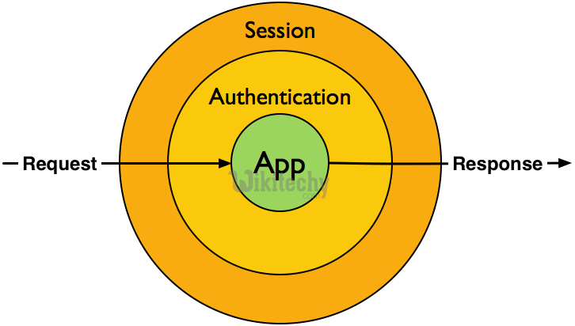
Laravel Session
What is session?
Make login form, route, and controller.
Store data in the session.
Get data from the session
Remove data from the session
A session is a way to store and access data across multiple pages of a website for a single user.
Session store data in the service side.
But manage with browser cookies

Slide 40
Laravel Flash Session
What is flash session?
Make Html form, route, and controller.
Store data in the flash session.
Display data from the session
A session is a way to store data only once
After page refresh or anything route request data will removed from flash session.
This is basically used for display error and success message

Slide 41
Upload and Display file
Make Small form to select file
Make a Controller for uploading file
Store file with auto generated name
Store File with the provided name
Make upload file public
Display file after upload.

Slide 42
Insert Data in MySQL DB Table
Set .env file config
Make Controller, Model, View
Make HTML Form
Create Table in MySql DB
Store Data in DB table
Get and Display Data from DB
Make View, Route and Controller function
Fetch data from the MySql table
Display data on UI
Delete Data from MySql Table
Make Delete Option for in Table
Make Route and controller function
Delete data from table
Redirect after delete

Slide 43
Populate Data in Input Fields From MySQL
Make the Edit option in the table
Make Route and controller function
Get data from table with ID
Make Html Form
Populate Data in input fields
Update Data in MySql Table
Make Put Request
Make Route and controller function
Update data in MySql Table
Search in MySql Database Table
Make Search Form
Make Route and controller function
Search and display data

Slide 44
Pagination with Mysql Data List
Apply Pagination with Database Result
Apply Pagination Link
Add Style
Delete Multiple Record with MySQL
Make a Checkbox with each row.
Make Form and delete button.
Make Route and Controller function.
Delete Records.

Slide 45
Building Layout with Component
What is Layout?
Make Home and About Page.
Make Component for layout.
Make layout with component
What is Layout?
Common template for:
reuse code
reuse common Ul
reuse style
and similar look and feel

Slide 46

Add Bootstrap
The layout continues from last part.
Use CSS and JS file for Bootstrap 5
Try some bootstrap component
use CSS and JS
Write CSS and JS
Use CSS and JS in a view
Uss CSS and JS with the layout
Use Internal CSS and js
Asset method for add CSS and JS

Slide 47
Layouts Using Template Inheritance
Make Layout
Add common code in Layout
Pass dynamic data from pages to layout
Use common style with layout
Use Bootstrap with layout

Slide 48
Stub Customization
Why Use Stub
Run Command
Customize Controller
Customize Model
Interview Question

Slide 49
Migration in Laravel
What is Migration
Make Table with Migration
Write code for Column Field
Migrate Database
Migration Important Command
How to reset Migration
Rollback Migration
Rollback steps, Refresh
Single File Migration

Slide 50
Seeding in Laravel
What is Seeding
How to generate seeder file
Data Seeding
Run Seeding for database
Interview Question

Slide 51
Laravel Maintenance Mode
What is Maintenance mode
How to apply maintenance mode
How to come out from maintenance mode
How to apply secret key with maintenance mode

Slide 52
Laravel Accessors
What is Accessors in Laravel.
Make Model, Controller and view.
Make 2 Accessors for example.

Slide 53
Laravel Mutators
What is Mutators in Laravel?
Make Controller function and route.
Make 2 Mutators for example.

Slide 54
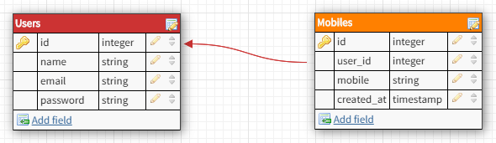
Laravel One to One Relationship
What is Relationship?
What is one to one relationship?
Example

Slide 55
Eloquent Relationship
Eloquent relationships are a powerful feature of Laravel that allows developers to easily work with related data
Eloquent relationships are a powerful feature get data from more than one table with any related field

Slide 56
Laravel One to Many Relationship
Laravel One to Many Relationship
What is one to many relationship?
Make function in model
Example

Slide 57
Laravel Many to One Relationship
One to Many (Inverse)
What is many to one relationship?
Make function in model
Example

Slide 58
Send Email in Laravel
Make Changes in .env file for mail config
Generate app and password in gmail
Make mail file
Make controller and route
Make email template
Send and Test Mail

Slide 59

Thank you

